Slide 1
A Complete Guide To gRPC
For Java Developers

Slide 2
Monolithic Application

Slide 3
MicroServices

Slide 4
Problem - 1: Request & Response Protocol
Service A
Service B
Service A
Service B
HTTP /book/41

Slide 5
Problem - 2: Headers
HTTP is stateless
Headers are sent in every request
Carries info like Cookie
Plain text - relatively large in size
Can not be compressed
Notes:
Gửi đi ,nhận về ở mỗi request, res nó chứa thông tin chủ yếu về client và server. CỤ thể là thông tin trình duyệt,cấu hình server, ngày tháng request page
Http2 thì có thuật toán để compress là HPACK
Reference:https://stackoverflow.com/questions/5333367/http-header-compression

Slide 6
Problem - 3: Serialization & Deserialization
“firstName”:“sam”
“firstName”:“sam”
Service A
Service B

Slide 7
Problem - 4: API Contract
“first_name”:“sam”
“firstName”:“sam”
Service A
Service B

Slide 8
Problem - 5: Client SDK
Java
JS
c++
Service
Ruby
Go
Python

Slide 9
Stubby
RPC Framework from Google
15 years
10 billions reqs / sec!!!!
Cross-platform
Tightly coupled with infrastructure

Slide 10
gRPC
Developed at Google
Inspired by Stubby
Released in 2016
Adopted by
Netﬂix
Microsoft
Notes:
gRPC: một Remote procedure call framework của Google dùng để giúp thực hiện các giao tiếp gRPC một cách nhanh chóng, nhẹ nhàng và hiệu quả. gRPC đã mang RPC kết hợp với protobuf (một định dạng file, cùng chức năng như JSON, XML nhưng nhẹ hơn, nhanh hơn và đơn giản hơn) và HTTP2 - phiên bản mới của HTTP và có nhiều cải tiến về tính năng cũng như tốc độ.
GRPC: hiểu đơn giản là phương thức cho phép một client gọi đến một thủ tục hàm của server khác

Slide 11
HTTP / TCP
HTTP 1.1 was released in 1997
TCP connection - 3 way handshake process
Signiﬁcant amount of time is spent in establishing a connection
Service A
Service B
HTTP /book/41

Slide 12

HTTP / TCP
Web Server

Slide 13
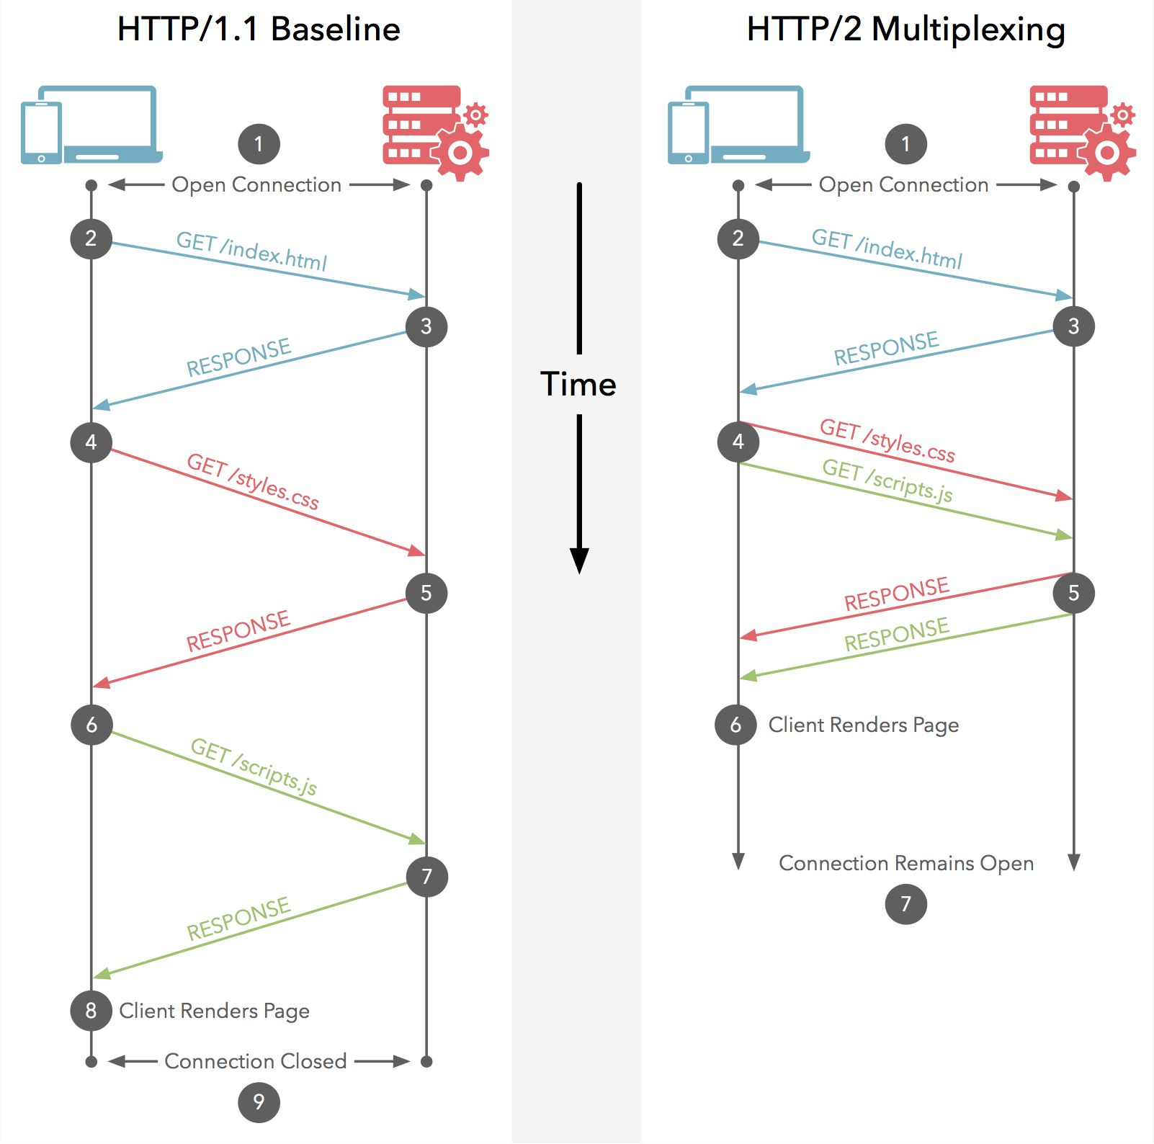
HTTP/1.1 vs HTTP/2
Web Server

Slide 14
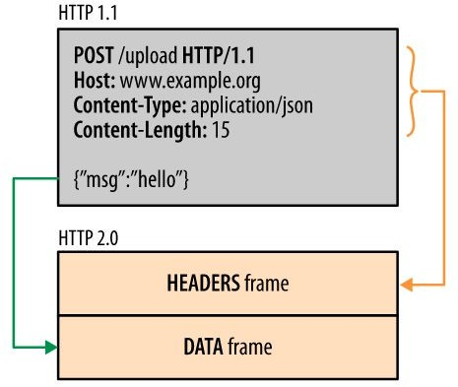
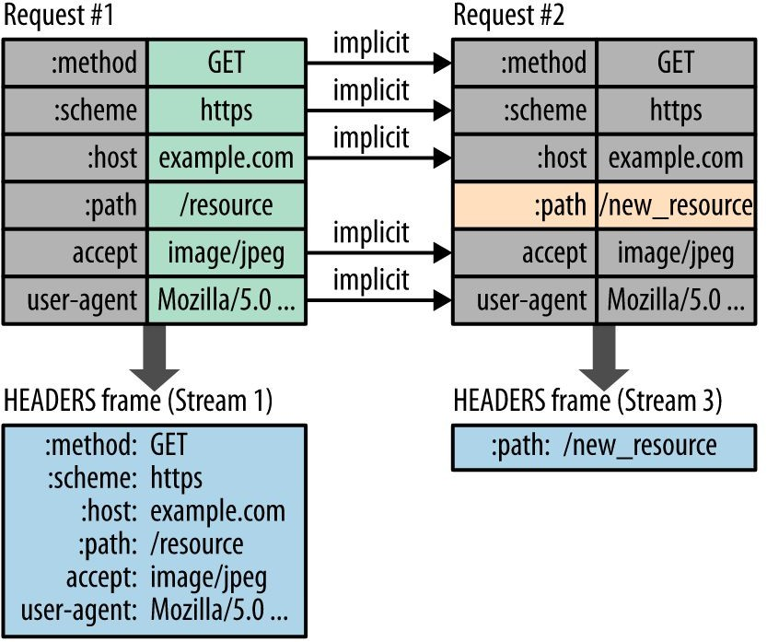
HTTP/2 vs HTTP/1.1
Binary
Header Compression
Flow Control
Multiplexing

Slide 15
gRPC - Beneﬁts
HTTP2 is default.
Binary
Multiplexing
Flow-control
Non-blocking, Streaming bindings
Protobuf
Strict Typing
DTO
Service deﬁnitions
Language-agnostic
Auto-generated bindings for multiple languages
Great for mobile apps

Slide 16
gRPC vs REST
REST
Architectural style
Resource oriented
~JSON + HTTP
gRPC
A RPC framework
More ﬂexible & Action oriented
Speciﬁc to inter-services communication

Slide 17
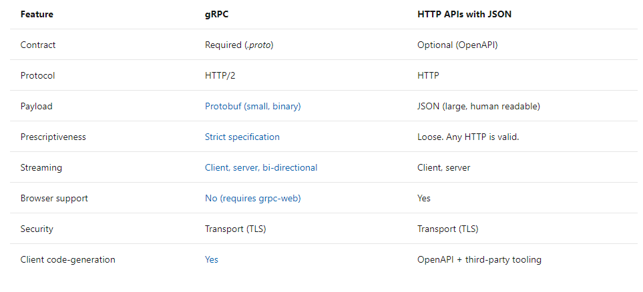

Slide 18
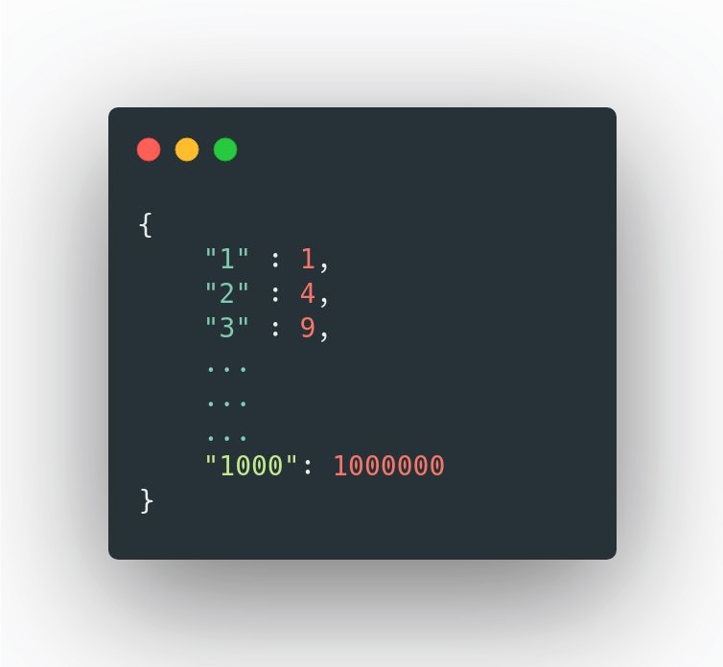
gRPC vs REST
rest-service
aggregator
GET /1000
grpc-service

Slide 19
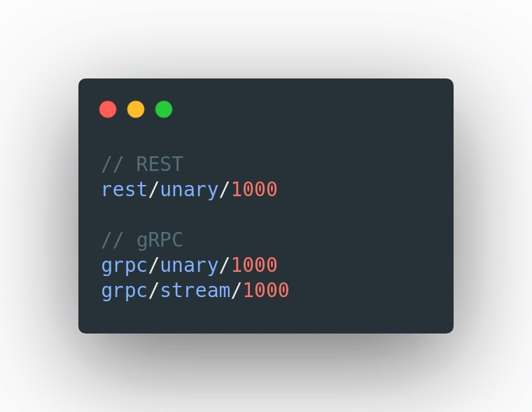
gRPC vs REST
rest-service
aggregator
grpc-service

Slide 20
Presentation Structure
Protocol Buffers / protobuf
gRPC
Client/Server application
Different types of RPC
Example:
Java code about type of data of Protobuf with Java
gRPC – Spring boot integration

Slide 21
Protocol Buﬀers
Notes:
tạo ra chuẩn sắp xếp mã hóa data với mục đích tạo buffer truyền và nhận giao tiếp một cách linh hoạt, hiệu quả, đơn giản và tăng tốc độ truyền nhận

Slide 22
Introduction
IDL (interface description language) for API
Serializing/Deserializing structured data
Very Fast / Optimized for interservices communication
Provides client libraries automatically for many languages!
Java
C++
Javascript
Go
Ruby
C#
Python
Notes:
chuẩn sắp xếp mã hóa data với mục đích tạo buffer truyền và nhận giao tiếp một cách linh hoạt, hiệu quả, đơn giản và tăng tốc độ truyền nhận cùng chức năng như json nhưng nhẹ và nhanh hơn

Slide 23
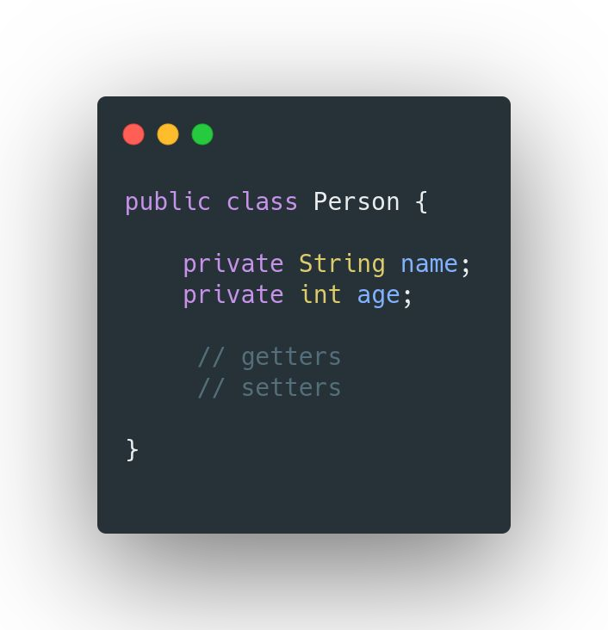
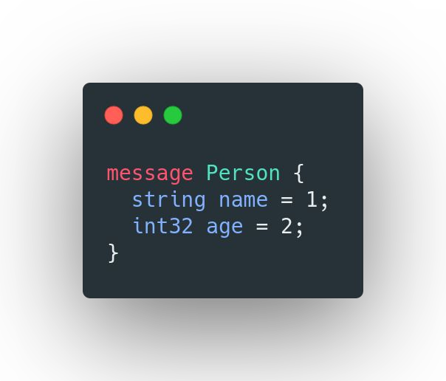
Sample Proto

Slide 24

Protobuf vs JSON - Performance Comparison

Slide 25
Types
Java Type | Proto Type
int | int32
long | int64
float | float
double | double
boolean | bool
String | string
byte[] | bytes

Slide 26
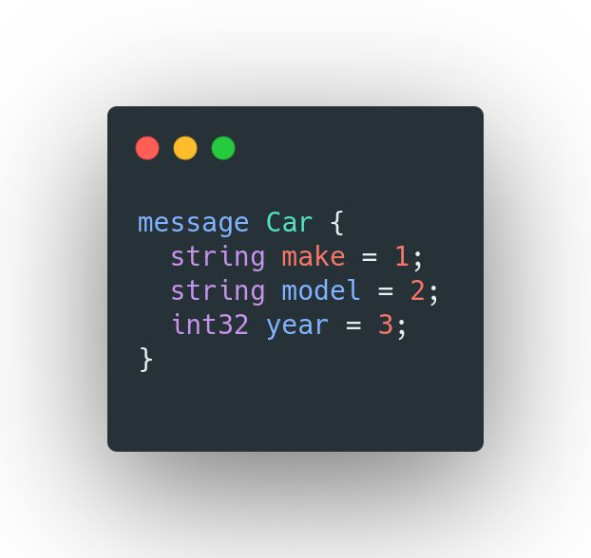
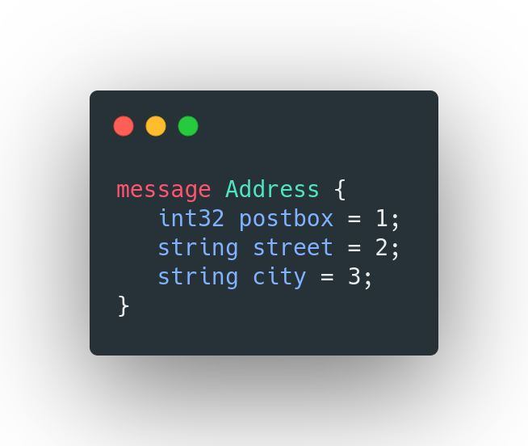
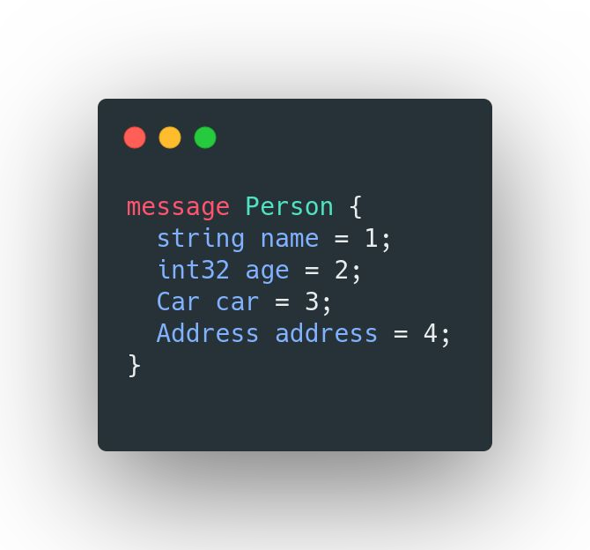
Proto - Composition

Slide 27
Proto - Collections & Map
Java Type | Proto Type
Collection / List | repeated
Map | map

Slide 28
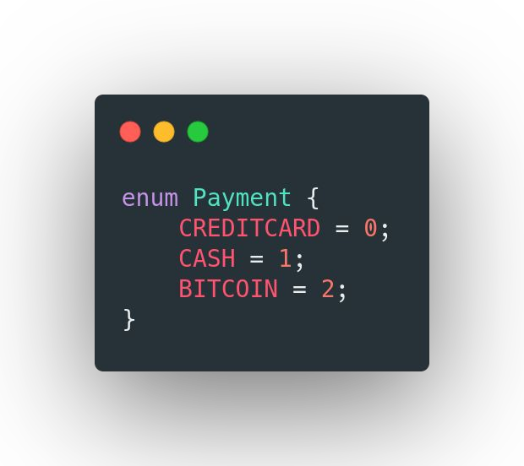
Proto - Enum

Slide 29
Default Values
Proto Type | Default
int32 / any number type | 0
bool | false
string | empty string
enum | first value
repeated | empty list
map | wrapper / empty map

Slide 30
Proto - Modules / Import
Proto ﬁles can be packaged & imported

Slide 31
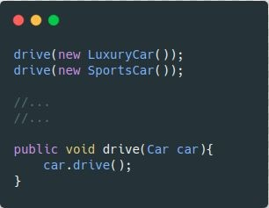
Java - Interface / Implementations
Car
SportsCar
LuxuryCar

Slide 32
Proto - OneOf
Email
Phone
Credentials

Slide 33
Proto - Field Numbers
Each Field is assigned with unique number.
1-15 for frequently used ﬁelds (uses 1 byte)
16-2047 - uses 2 bytes
1 is smallest
2²⁹ - 1
19000-19999 - reserved
Do not change the ﬁeld number once it is in use

Slide 34
Proto - Guidelines
1-15 for frequently used ﬁelds
Do not reorder the ﬁelds once it is in use
Adding New ﬁelds will not break old proto
Removing ﬁelds will not break old proto
Use reserved
Changing Type
int32 → int64 is OK
int64 → int32 might be a problem
Renaming is OK. but be cautious.
Keep the protos as separate maven-module and add them as dependency in other modules

Slide 35
gRPC

Slide 36
gRPC - Introduction
High-performance, open-source RPC framework
Developed at Google
Client app directly invokes Server method on a different machine
Service is deﬁned using proto
.proto

Slide 37
gRPC - Synchronous vs Asynchronous
Client’s call to the server can be Sync/Async
Sync → blocking / waiting for the response
Async → Register a listener for call back
It is completely up to the client
It also depends on the RPC

Slide 38
RPC - Types
Unary
Server-streaming
Client-streaming
Bidirectional-streaming

Slide 39
gRPC - Services Communication
Client
Server

Slide 40

StreamObserver
CashDeposit stream observer
Balance stream observer

Slide 41
Bi-directional Stream
TransferRequest stream observer
TransferResponse stream observer

Slide 42
Response - Streaming vs Single
Streaming
Size - Potentially large / unknown
Ex: Pagination
Uber-eats
Receiving side might take too much time to process
File upload
More efﬁcient than multiple RPC calls
Bi-Directional Stream → Client/Server streams are completely independent
Single
More efﬁcient than streaming RPC
Size is small

Slide 43
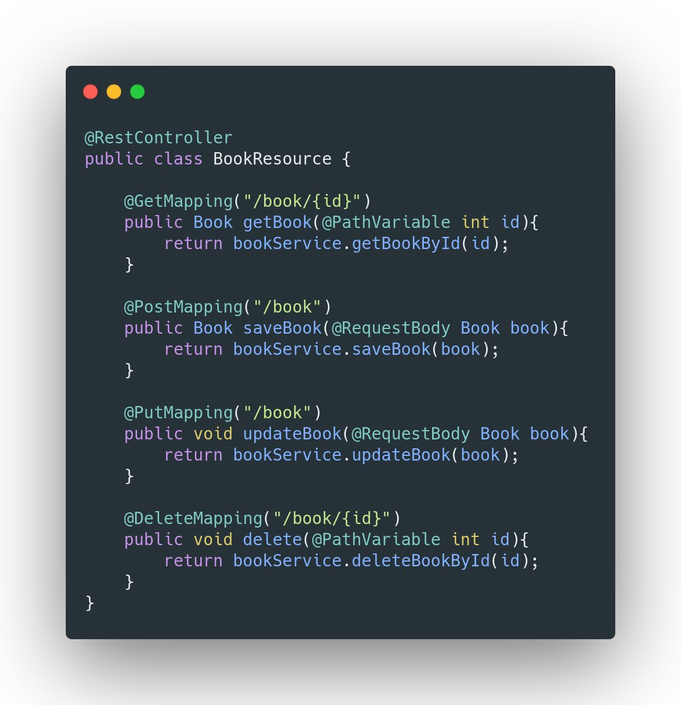
REST - CRUD
GET
POST

Slide 44
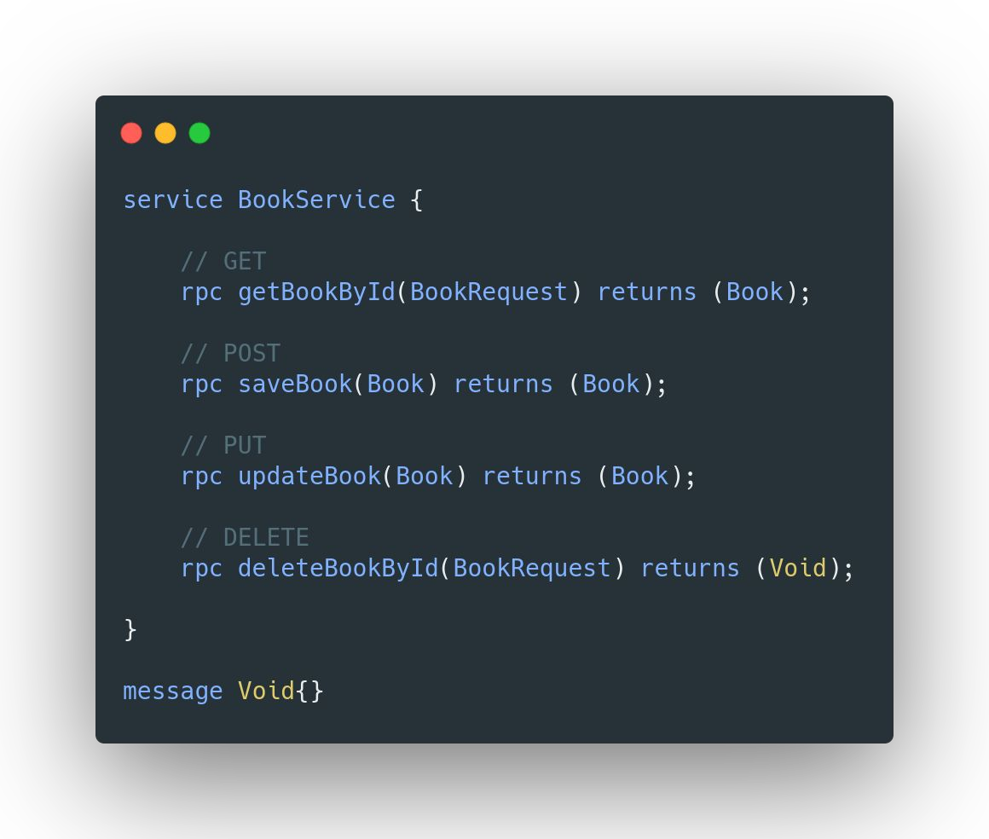
gRPC - CRUD

Slide 45
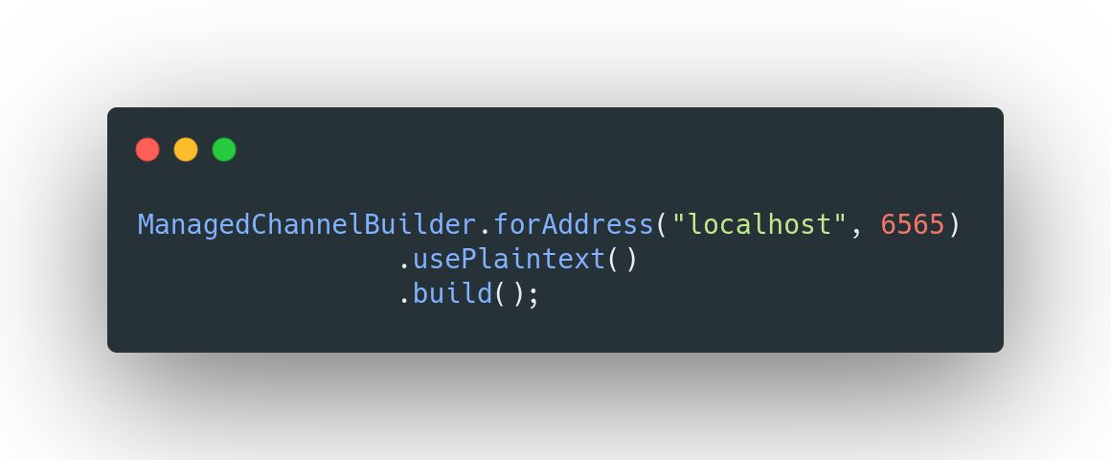
gRPC - Channel

Slide 46
gRPC - Channel
Channel is an abstract over a connection and represents the connection
Connection is persistent
Connection creation is Lazy & established during the ﬁrst RPC
1 channel / connection is enough for client/server communication even for concurrent requests
You can also create more channels - but not really required.
Channel creation is an expensive process.
Close when the server shuts down
Thread safe!
Can be shared with multiple stubs for the server

Slide 47
gRPC – some advanced Topics

Slide 48
gRPC - Deadline
Timeout for an RPC to complete!

Slide 49
gRPC - Interceptor
We can intercept RPCs both at client and server side.
To handle Cross-cutting Concerns

Slide 50
gRPC - Interceptor

Slide 51
gRPC - Key/Value Pairs
Metadata
CallOptions
Context

Slide 52

gRPC - Attaching User Token
Metadata

Slide 53
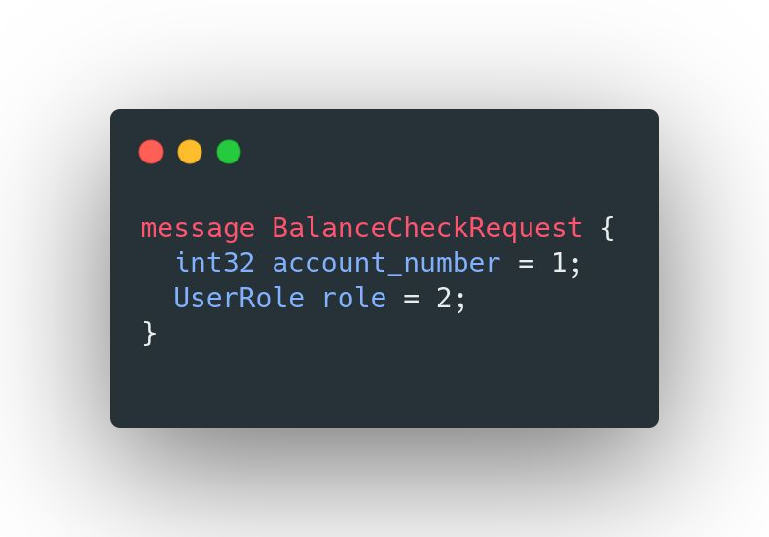
gRPC - Passing User Role via Context
Metadata
Context

Slide 54
gRPC - Metadata
Key/Value pairs
Value can be a String or Binary data or an Object
To pass information between Client & Server

Slide 55
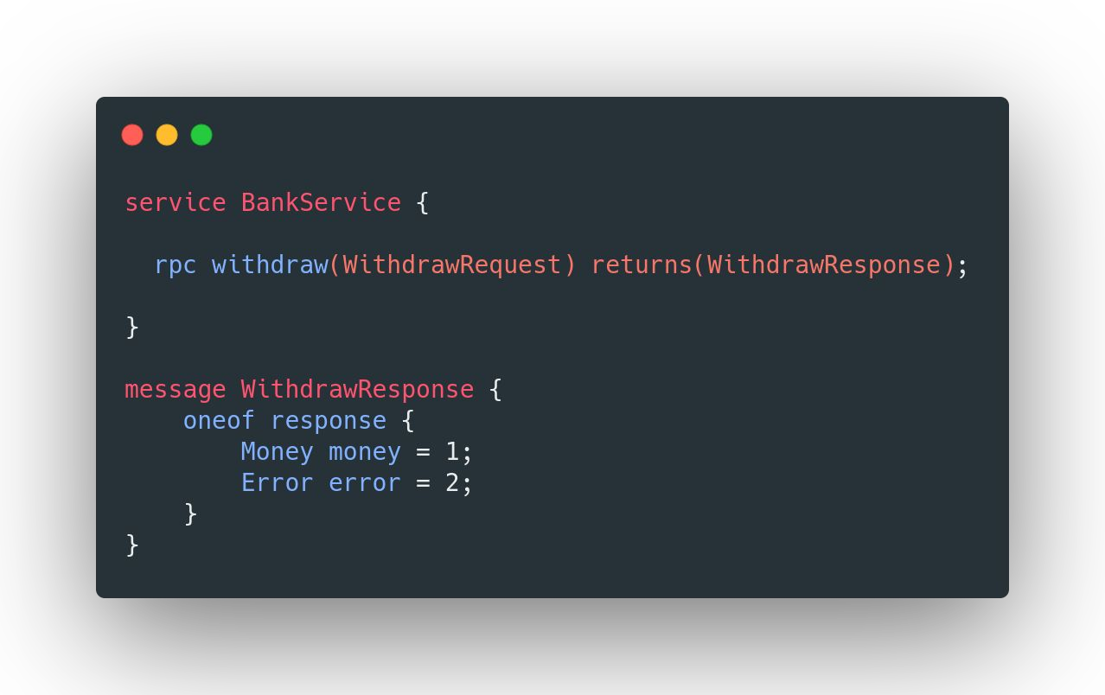
gRPC - Error Handling
Error channel
Status codes
Metadata
Data channel
OneOf

Slide 56

gRPC - SSL/TLS
CA
mybank.com
https://mybank.com

Slide 57

gRPC - Executor
CachedThreadPool - default
directExecutor → Better performance for non-blocking app
FixedThreadPool → Preferred

Slide 58
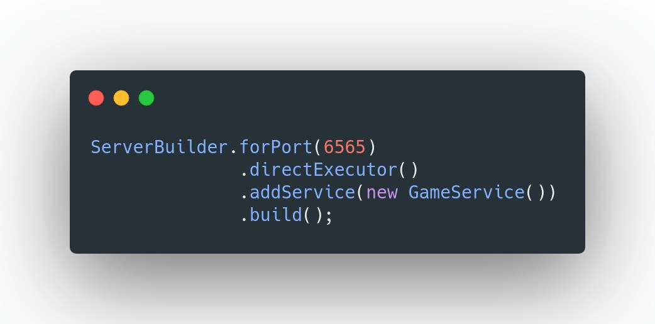
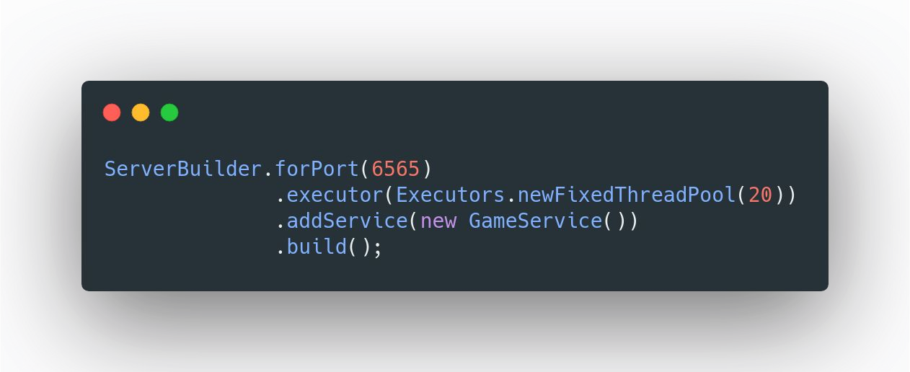
gRPC - Executor

Slide 59
gRPC - Spring Boot Integration

Slide 60
gRPC - Web
HTTP1
Microservice / GraphQL / Envoy

Slide 61
gRPC - Spring Boot Integration
user-service
aggregator
movie-service

Slide 62
gRPC - Load Balancing

Slide 63
gRPC - Load Balancing
order-service
payment-service

Slide 64
gRPC - Server-Side Load Balancing
payment-service
order-service
proxy

